Slide 1
ONLINE SAFETY
Online devices and rules and agreements about their use
Parental controls
Social media and gaming
Use of AI
Staying safe online and reporting concerns
Support available
Notes:
ASK: What rules do you set for your children? How confident are you in implementing them?

Slide 2

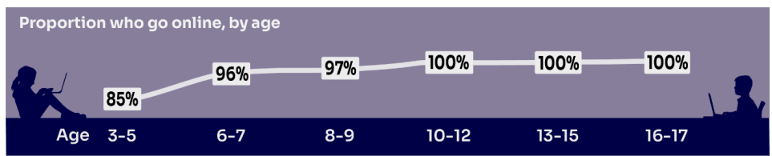
HOW MUCH DO YOU KNOW about your child’s life online?
Almost all children (96%) aged 3 – 17 went online in 2024, highlighting the centrality of the internet in their lives:
    Younger children commonly use tablets to go online
    Older children are more likely to use mobile phones
Source: Children and parents: media use and attitudes report 2025
Notes:
TELL:
We will be looking at 3–17-year-olds patterns of media use, how they access different sources of media online, and the types of online activities they are participating in. This includes their behaviours and habits in terms of viewing, playing, learning, and interacting
Almost all children from aged 5yrs (96%) went online in 2023, highlighting the centrality of the internet in children’s lives.
And we mustn’t forget that being online does create a lot of opportunity and joy for most of us. So, let’s think about how we can minimise risk and reduce their exposure to harm.

Slide 3


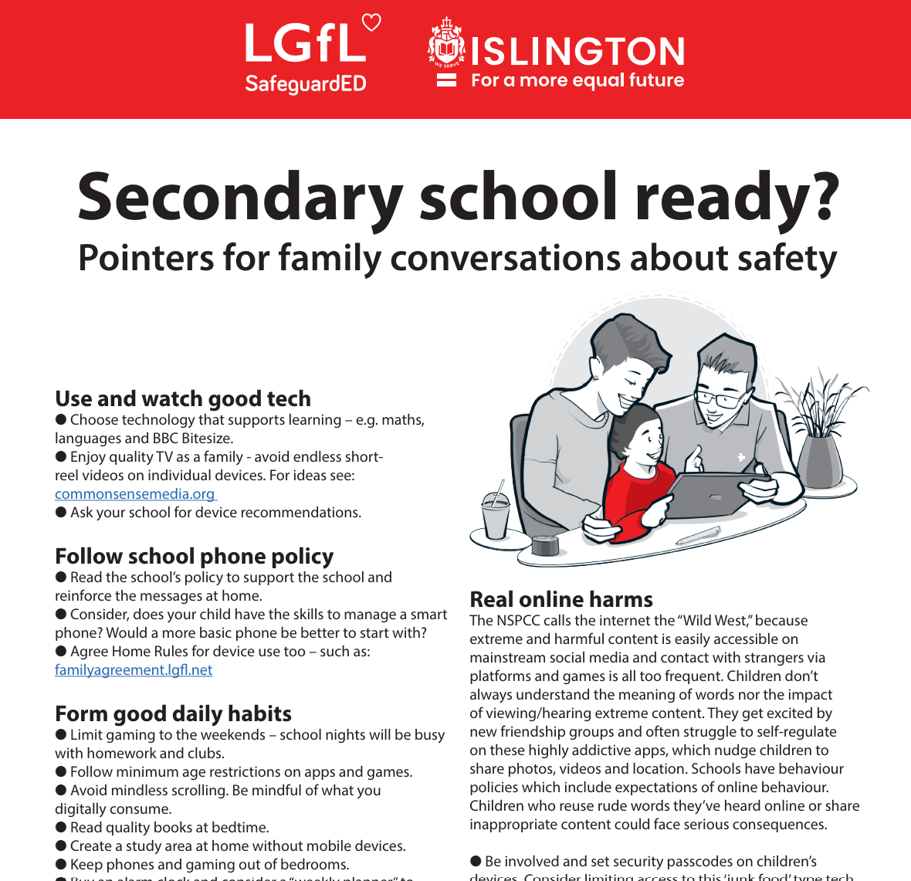
SMARTPHONE or ‘NON’-SMART / BRICK phone?
REMEMBER IT’S YOUR CHOICE
Every child and situation is unique,
and you are best placed to know their needs
Internet access
Social media, apps and games
Notifications
Anytime connection
Parental controls
NO internet access
Some games
Anytime phone calls and texts
Limited parental controls
Notes:
ASK THEM TO CONSIDER:
How will they reduce any risks?
What does their child need the mobile for? Is it simply to stay in touch with you - then a ‘non-smart’ phone might be enough. But if you want them to access homework or learning on their mobile, then a smartphone might be better.
How you can help them child learn the basic skills to use it safely e.g. to send a message, take part in a group chat, manage their timings etc. Children need our support with developing these skills. You wouldn’t give your child a knife without guidance and support, similarly a phone can cause harm and so need to think about this.
Whatever they decide, communication is key - involve the child in the process to establish shared expectations.
Remember to set up parental control settings or use a parental controls app to help them stay safe.

Slide 4
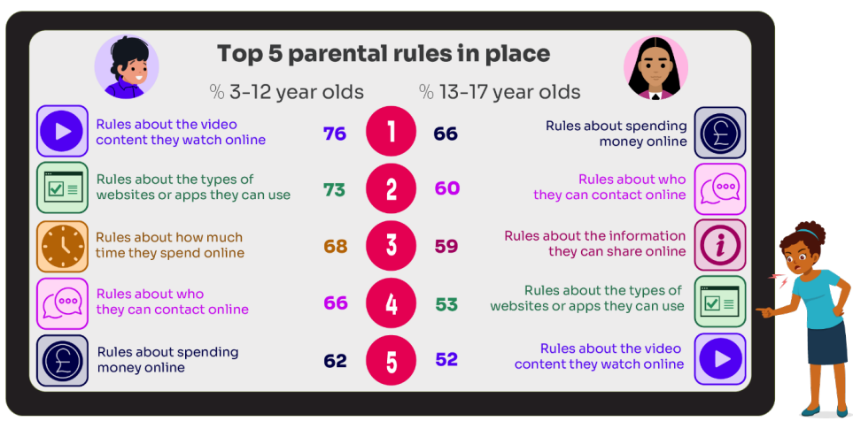
What RULES do YOU SET about being online?
What do you do that WORKS?
Source: Children and parents: media use and attitudes report 2025
Notes:
ASK: What rules do you set for your children? How confident are you in implementing them?

Slide 5

Why not have a family agreement to:
clarify what is allowed...or not
establish ground rules like no phones at the table or in the bedroom at night-time
agree shared expectations to reduce arguments and keep everyone safe & healthy
Download it at parentsafe.lgfl.net/digital-family-agreement
Notes:
TELL:
To help facilitate this, LGfL have created a free digital family agreement that parents could sit down and populate with all family members to agree what is and is not allowed within their family around tech use. This includes parents! WE as parents also need to role model good behaviour.

Slide 6
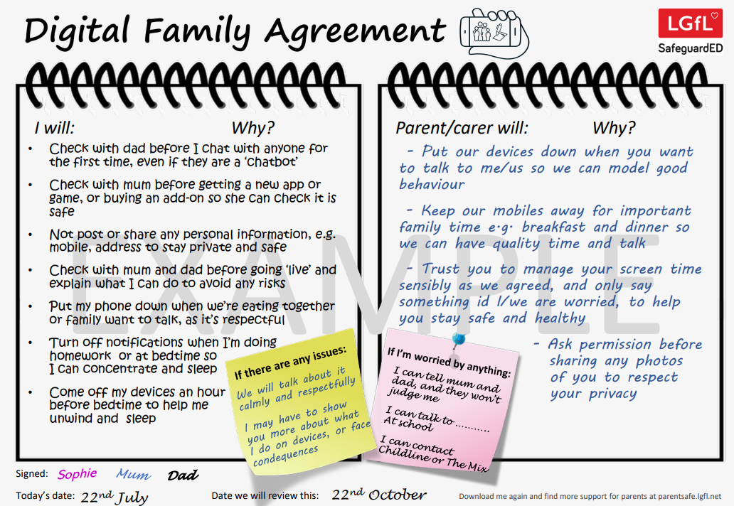
parentsafe.lgfl.net
Notes:
TELL - This is an example of a completed agreement – you may wish to take them through the sample statements to help them get started.
ASK – Have they heard of the term ‘Sharenting’?

Slide 7

Have you set up parental CONTROLS/PRIVACY SETTINGS for ALL DEVICES and NETWORKS?
Controls need to be set up on both the broadband connection AND each individual device
These do not come as standard so it’s worth checking
They are important because they allow you to:
  Block and filter upsetting or inappropriate content or sites
  Plan what time and how long your child can go online for
Notes:
TELL – it is important that these controls are set up on BOTH the broadband connection AND each individual device
About seven in ten (73%) parents of all 3-17-year-olds use at least one type of technical tool or control to manage their child’s access to online content; parents of 8-11-year-olds are more likely than those of older children to use at least one of these tools (84% vs 70% of parents of 12-15s and 54% of parents of 16-17s respectively). The most commonly-used technical tool used, across all parents of 3-17s, were parental controls built into the device by the manufacturer, e.g. Windows, Apple, Xbox, PlayStation etc. (32%). (Ofcom 2024)

Slide 8
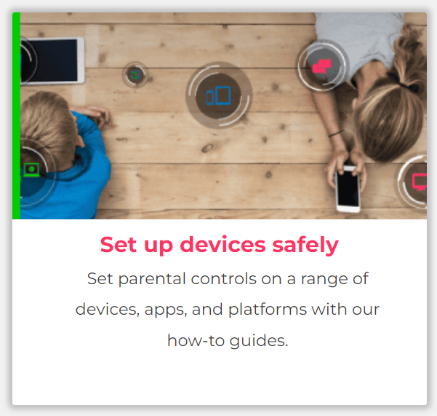
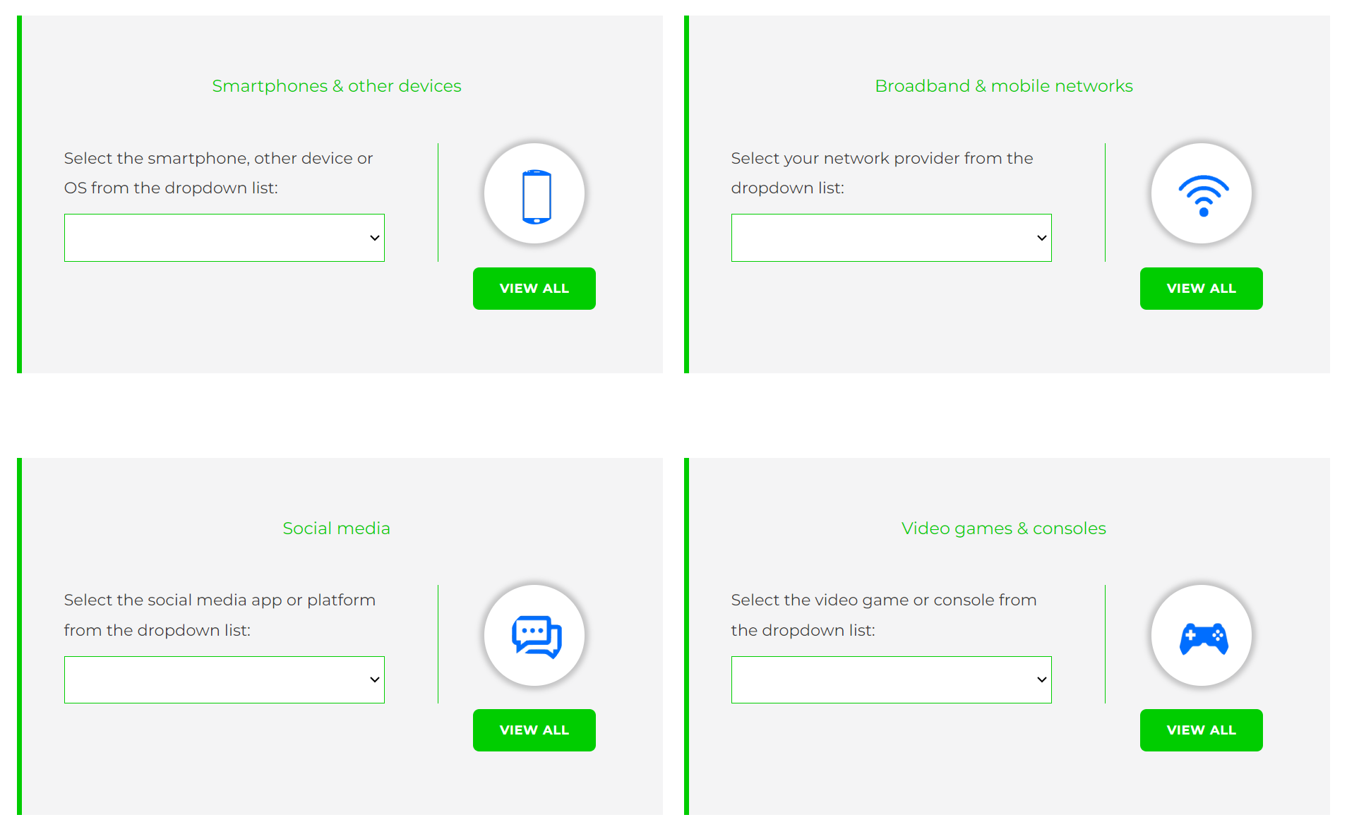
Visit internetmatters.org/parental-controls to find out how to set controls on devices:
Notes:
TELL – They can use this great page to find out how to set up controls on any smartphone, broadband, social media site/app and games console
REMIND - They need to set up parental controls on each of these individually

Slide 9
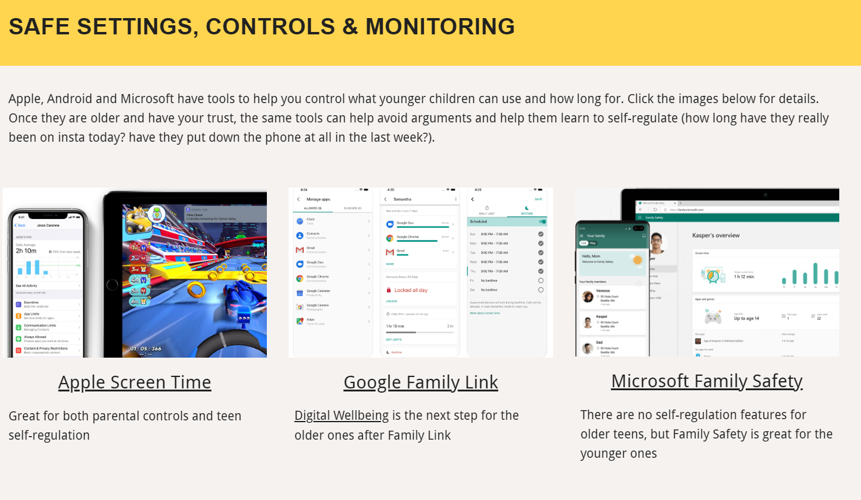
Parental control apps like Google Family Link, Screen Time and Microsoft Family can let you set limits across devices, apps and platforms
Visit parentsafe.lgfl.net/ for additional advice and tips on settings and controls for all devices
Notes:
EXPLAIN - As well as setting controls on your broadband, device, apps, games etc, Parental Control Apps like Google Family Link, Screen Time and Microsoft Family can further enhance safety by letting you set limits across devices, apps and platforms without needing to access these spaces separately. You can manage screen time, app access, inappropriate content restrictions and more.
Screen Time shows you how much time you spend on apps, websites and more. You can also set limits and restrictions for what you want to manage – on your own device or a child's device.
Family link can run on Android devices, e.g. Samsung… Parents can access and manage their child’s account and settings, and delete it if necessary
TIP – Why not run a ‘Bring your device and we’ll show you….’ pupil-led workshop to help parents with this at school?

Slide 10



REMEMBER
As children get older, restrictions and controls you use will change, but only at a pace you feel is appropriate for your child, not pressure from your child “because everyone else is allowed”
Content filters are never 100% effective, at some point your child may come across inappropriate or upsetting content, so make time to talk regularly

Slide 11
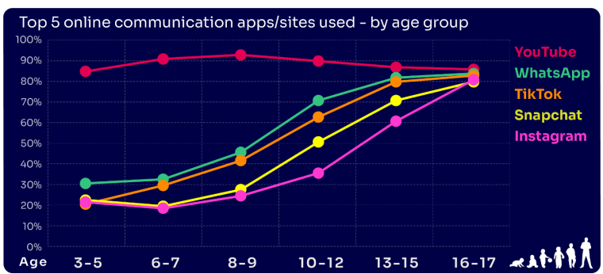
Are you FAMILIAR WITH THE APPS and GAMES your child is on?
YouTube is the most popular, but the appeal of many social media platforms varies by age
The two most popular apps for 3 – 7 yr-olds are WhatsApp (2 in 10) and Snapchat (3 in 10)
The proportion of 8-9s with an Instagram profile increased from 8% in 2023 to 14% in 2024
Go to apps.lgfl.net for guidance on apps and social media sites
Source: Children and parents: media use and attitudes report 2025
Notes:
YouTube continues to be universally popular, and the appeal of other social media platforms increases with age . nearly half (48%) of 16-17s use all of the top five apps/ sites that we asked about (YouTube, WhatsApp, TikTok, Snapchat and Instagram).
REMIND – your children need to be 13+ to use these platforms (See slide 39)

Slide 12

WHY DOES THIS MATTER?
Young people can get around age restrictions on apps and websites, increasing the risk of them coming to harm online
Addictive algorithms can make it harder to take a break and maintain a healthy balance between time on and offline
Algorithms can also target content similar to what you’ve already selected/liked/shared
This can prevent you from finding new ideas and perspectives, create misinformation and reinforce stereotypes
Notes:
ASK – What kinds of risks do you think children could be exposed to? Can you give examples? (See slide 48 for a summary of related risks)

Slide 13
So what are the RISKS?
content: being exposed to illegal, inappropriate, or harmful content, for example: pornography, racism, misogyny, self-harm, suicide, antisemitism, radicalisation, extremism, misinformation, disinformation (including fake news) and conspiracy theories.
contact: being subjected to harmful online interaction with other users; for example: peer to peer pressure, commercial advertising and adults posing as children or young adults with the intention to groom or exploit them for sexual, criminal, financial or other purposes
conduct: online behaviour that increases the likelihood of, or causes, harm; sharing and receiving explicit images (e.g. nudes and semi-nudes and/or pornography and online bullying
commerce: risks such as online gambling, inappropriate advertising, phishing and or financial scams
Keeping Children Safe in Education
Notes:
TELL - The 4 Cs of online safety is a useful way to identify online safety risks for children (content, contact, conduct and commerce)
We will now take a look at some of these in more detail over the next few slides

Slide 14


What might they NOT BE TELLING YOU?
Nearly six in ten (56%) 8-17s use multiple profiles on at least one social media platform:
(23%) said it was because one account was just for parents/family to see
15% said one account was for the ‘real me’ and another contained edited/filtered posts or photos
Source: Children and parents: media use and attitudes report 2025
Notes:
TELL - This demonstrates that at least some children feel the need to present distinct aspects of themselves on social media, depending on the audience.

Slide 15
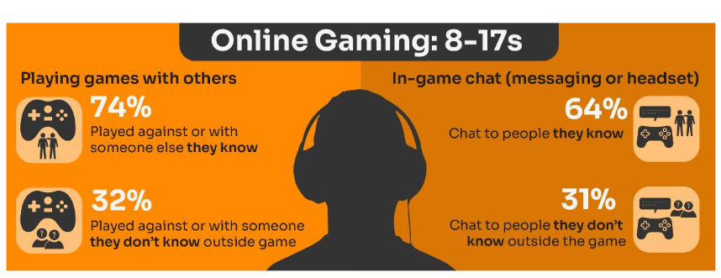
Do you know the DIFFERENCE between an ‘ONLINE’ FRIEND and a real one? How does this differ from your CHILD’S VIEW?
Are you familiar with who they are in contact with whilst playing games?
Have you asked about the chat facility?
Do you know the content and age restrictions for these games?
Visit gaming.lgfl.net for advice and activities
Source: Children and parents: media use and attitudes report 2025
Notes:
TELL:
Children often use online gaming as a tool to communicate with their peers, with 64% of 8-17s who game online chatting through the game with friends and/or people they know in real life.
However, 31% of children who game online, communicate with strangers as well.
A higher proportion of these children now play shooter games. This may raise concerns about how age appropriate the games favoured by some younger children actually are.
While communication via games is a valuable social tool for many children, it can sometimes leave them vulnerable to unwanted interactions. This year (12%) of all children aged 8-17 said someone had been nasty/hurtful to them through an online game

Slide 16
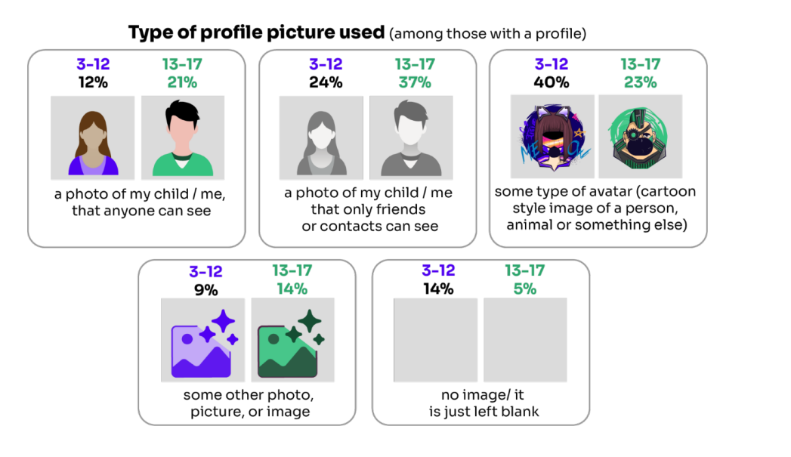
Do you know what they SHARE?
Source: Children and parents: media use and attitudes report 2025

Slide 17
Being safer while live streaming
Use devices in public spaces e.g. lounge not bedroom
Talk to them about what they are sharing
Check privacy and safety settings on the app/site
Be wary of requests to chat in private
Know Support and Reporting functions
Notes:
Other tips to consider if you know your child live streams

Slide 18
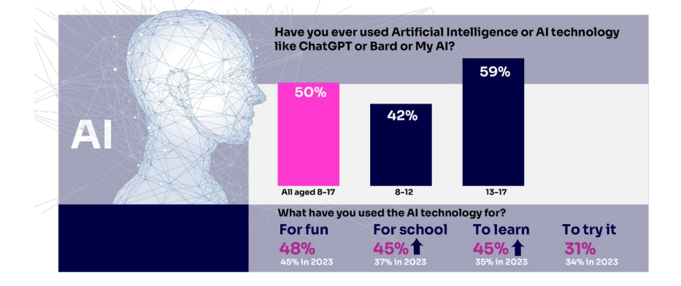

Half of children say they use artificial intelligence (AI) tools
https://www.childnet.com/wp-content/uploads/2025/03/Childnet-Cheat-Sheet-GenAI.pdf
Source: Children and parents: media use and attitudes report 2025
Notes:
ASK – What does Gen AI mean to you?
TELL -Al systems are designed to complete tasks and solve problems that in the past would have needed human thinking. Generative Al (genAl) allows us to ask Al to create things for us, such as photos, music, emails, and recipes and is able to work with and process vast amounts of information to complete the task it is set. GenAl can be found on many different platforms, apps and websites.. Children and young people often use Gen AI for:
Asking questions
Studying and revision
Getting advice
Planning
Coding
Being creative through art or music
For ideas and inspiration
Drafting messages and emails
Analysing data
EXPLAIN: Lots of talk about pupils using it to cheat in coursework but perhaps not as much about some of the very real safeguarding risks
Let’s not forget many gen-ai apps are publicly available to EVERYONE. Many mainstream Social Media and Education Platforms have chatbots or gen-ai functions too!
An Internet Matters report warns vulnerable children are most at risk, with the survey finding 71% of vulnerable children are using AI chatbots. A quarter (26%) of vulnerable children who are using AI chatbots, say they would rather talk to an AI chatbot than a real person, and 23% said they use chatbots because they don’t have anyone else to talk to.
SHOW – Childnet’s Parent Leaflet and scroll through key strategies and pointers to help keep children safe: - https://www.childnet.com/wp-content/uploads/2025/03/Childnet-Cheat-Sheet-GenAI.pdf

Slide 19
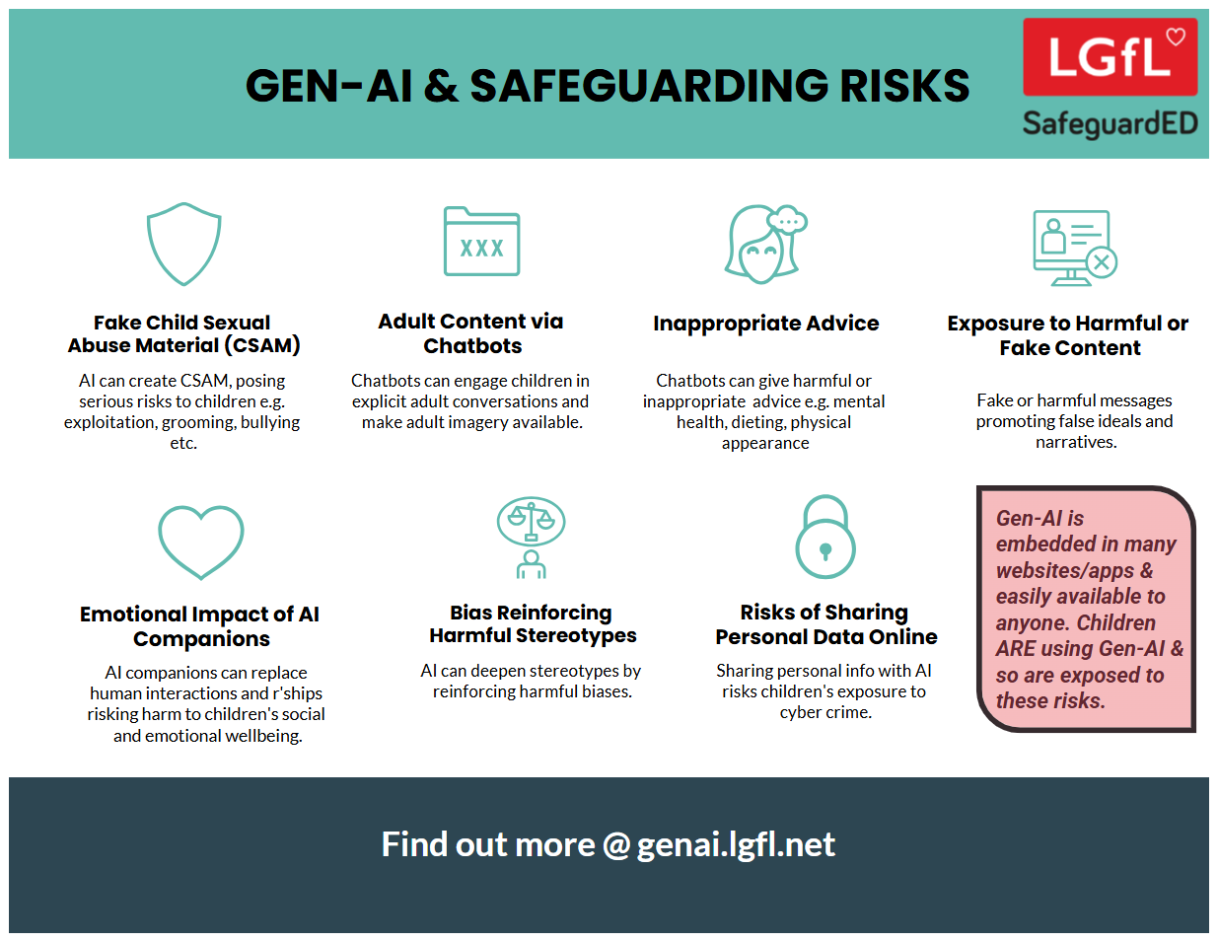
Notes:
Take them through some of the key points from this poster highlighting the safeguarding risks of Gen-AI

Slide 20
What about WHATSAPP?
Do you know the minimum age to use this? What are the risks?
Unwanted contact | to contact somebody on WhatsApp, all you need is their phone number, which could expose you to unwanted messages or calls
Inappropriate content | messages are end-to-end encrypted which means that the content cannot be monitored. This means that your child could see or hear harmful or upsetting content e.g. pornography or violence.
Location sharing | live location feature means that your child could reveal their current location to others
Cyberbullying | children could be bullied, feel left out or deliberately excluded or removed from groups
Oversharing | privacy features, such as disappearing and ‘view once’ messages, might mean that your child feels safe to reveal private or risky information or images. However, there is always a risk that this could be copied and shared
Notes:
TELL - WhatsApp let users send messages and content to contacts added to their account. To use the service in the UK, users must be 13-years-old or older (as of April 2024. The minimum age for WhatsApp used to be 16)

Slide 21
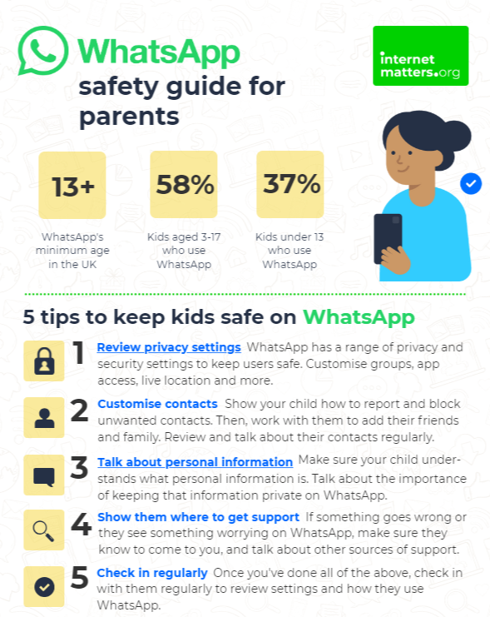
What can you do?
Visit https://www.internetmatters.org/resources/whatsapp-safety-a-how-to-guide-for-parents/#whatsapp-safety-tips for advice for parents
Notes:
SHARE – 5 top tips from the parent safety guide at https://www.internetmatters.org/resources/whatsapp-safety-a-how-to-guide-for-parents/#whatsapp-safety-tips
EXPLAIN – it’s useful to talk with children about etiquette when using group chats e.g.
how to communicate
what language to use/not use
recognition that others may see your messages if copied and shared
what to do if someone is unkind to them or others etc.

Slide 22
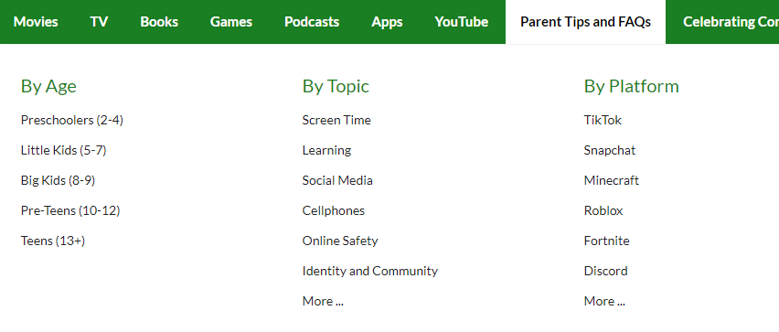


Find ratings and reviews for parents on apps, games and social media at commonsensemedia.org
Notes:
REMIND – they don’t need to be experts, but they can empower themselves by finding out about the suitability of the games/apps their child uses
SHOW – the Common Sense Media page and pick an app or game to show how easy it is to find a review

Slide 23
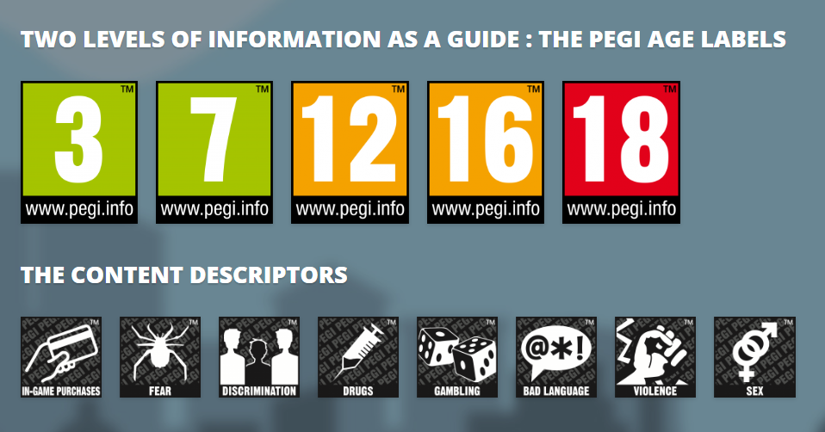
PEGI helps parents to make informed decisions when buying video games:
The age rating confirms that the game content is appropriate for players of certain age
It considers the age suitability of a game, not the level of difficulty
pegi.info
Notes:
UK uses the PEGI (Pan European Game Information) system to give games their age ratings to help people make informed decisions when buying video games or apps through the use of age recommendations and content descriptors. .You can find out more here: https://parentzone.org.uk/article/pegi-games-ratings#:~:text=The%20UK%20uses%20the%20PEGI,about%20how%20PEGI%20classifies%20games.

Slide 24




UK Reporting Helplines and Services for Children and Young People
NCA
Young people can report concerns about child sexual abuse and exploitation to NCA
Report Remove
A free tool that allows children to report nude or sexual images and videos of themselves that they think might have been shared online
ChildLine
A free, private and confidential service where CYP can talk about anything to a trained counsellor, online or on the phone
Call 101 or 999 if there is an immediate risk of harm to your child
Go to reporting.lgfl.net to find out more
Notes:
TELL – Talk to your children about these free reporting helplines to support them if they are worried.
For older children, The Mix provides help for young people aged 11-25

Slide 25
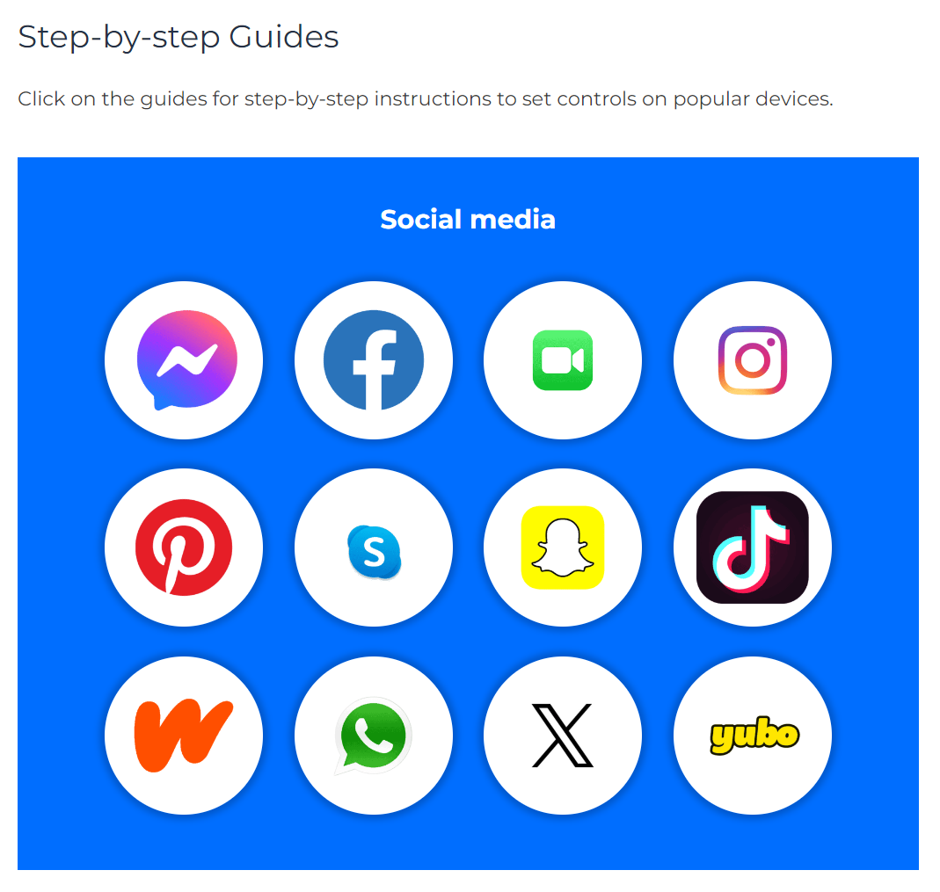
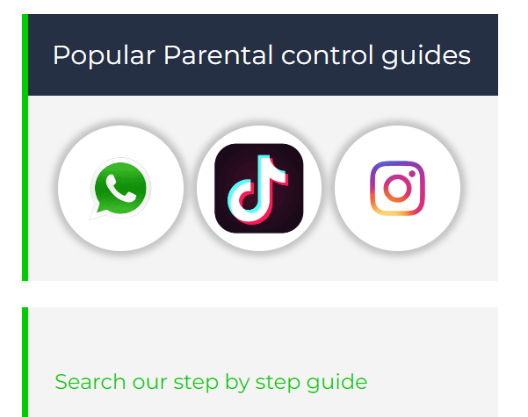
Do YOU know HOW TO REPORT to apps / sites?
Internet Matters has helpful guides for social media apps and sites at internetmatters.org/parental-controls/social-media
Notes:
Each social media site has it’s own processes for reporting inappropriate/harmful content.

Slide 26

Visit parentsafe.lgfl.net for tips and ideas to help parents:
Manage screen time
Set controls and settings
Understand apps and games
Talk to children about risk - from bullying & sharing content, to extremism & gangs
Notes:
TELL:
Remember, the online world can be both exciting and treacherous. Just as you’d look both ways before crossing the street, take a moment to assess the digital landscape.
Stay informed, stay connected, but most importantly, keep talking to your child.
ParentSafe is a dedicated website for parents, to help them to stay up to date with online safety and empower them to have meaningful discussions with their child to keep them safe.

Slide 27
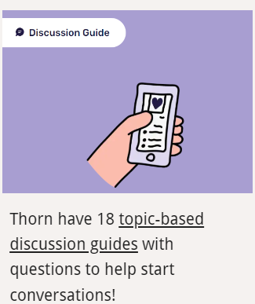
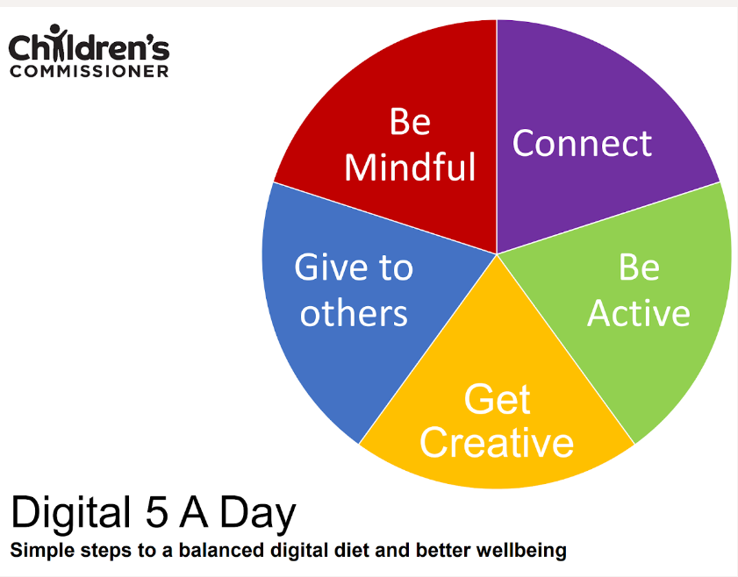




Find conversation starters, story time ideas and top tips to reinforce key safety messages at parentsafe.lgfl.net
Source: Children and parents: media use and attitudes report 2024
Notes:
You may wish to scroll through parentsafe.lgfl.net and showcase some of the resources or videos here too. We’ve selected a few in the following slides for you, but feel free to choose any relevant resources to suit your audience.

Slide 28
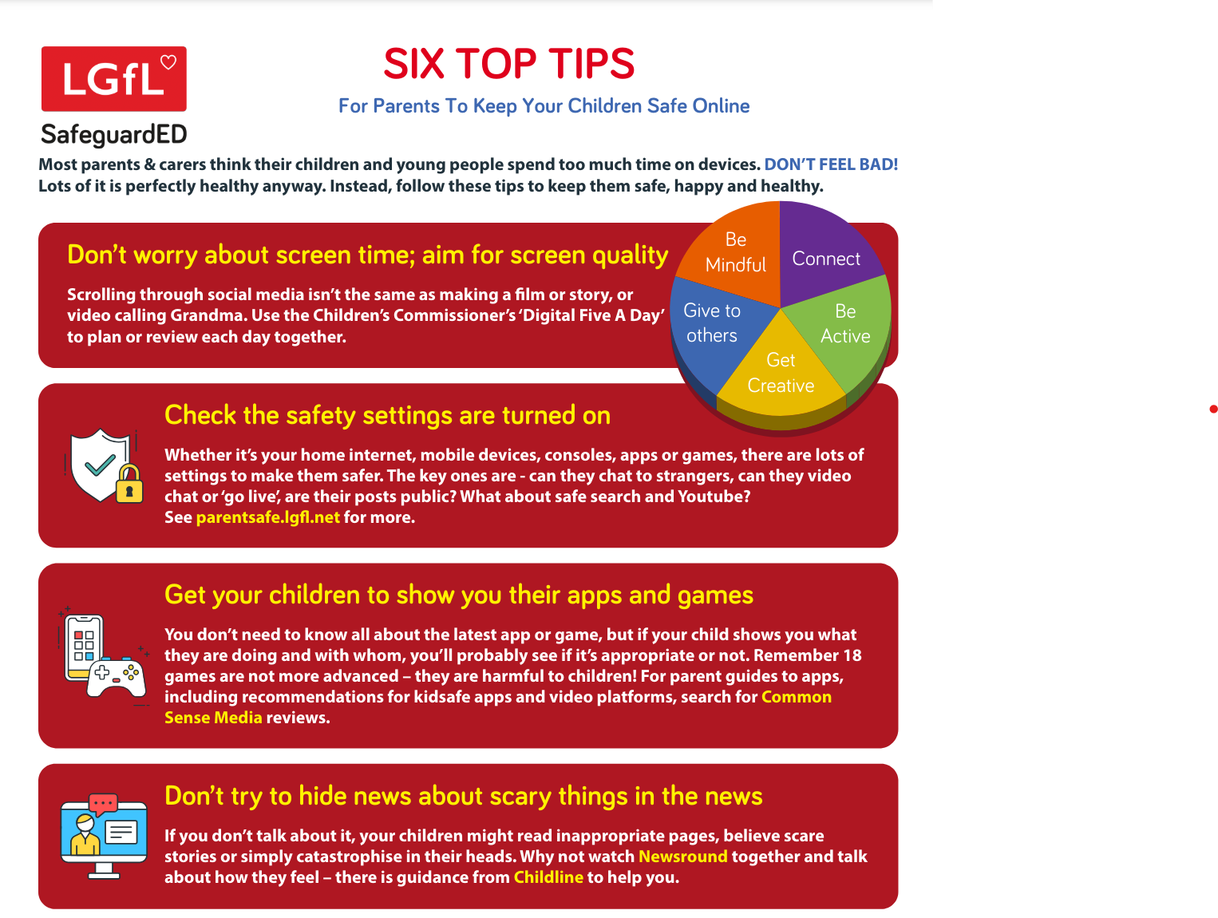
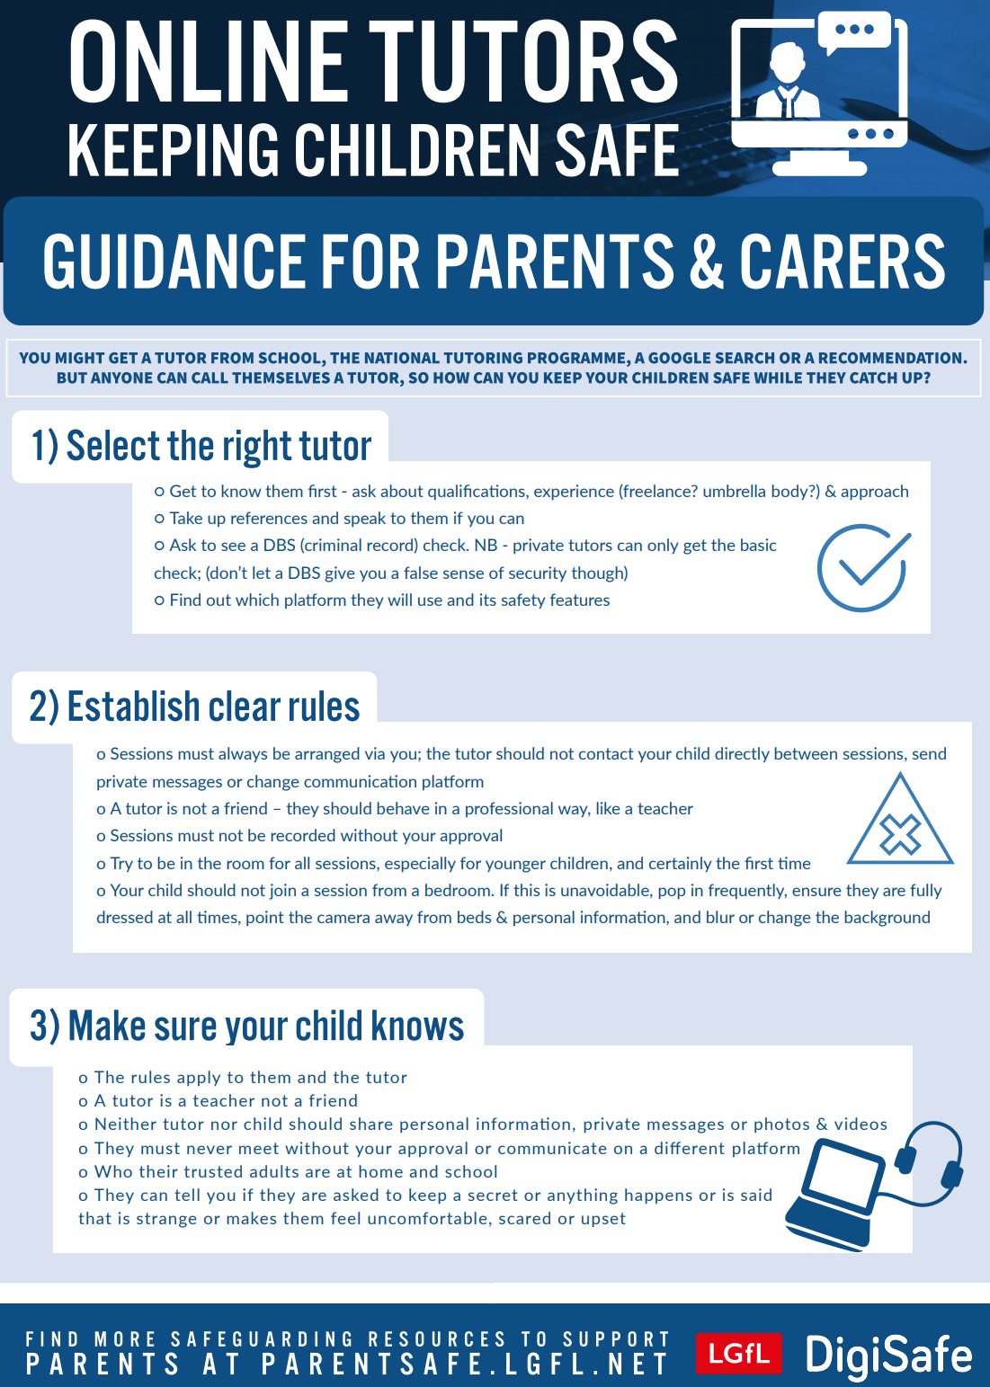
Notes:
TELL - why not put this fridge-friendly poster on your fridge?

Slide 29

If appropriate, report your concerns to school.
The class teacher is your first point of contact and we also have a Designated Safeguarding Team.
Notes:
Please amend this slide with anything further you want to tell parents about reporting concerns to the school and seeking help

Slide 30
Remember!
Before signing up to any app/site
check that your child meets the minimum age requirement
Remind your child to be cautious about accepting friend requests:
a real friend is someone they/you know in real life, not a ‘friend’ they met gaming or in a chat room.
Stress the importance of not sharing personal information with online ‘friends’
Keep passwords confidential
Check their privacy settings
emphasise the importance of not sharing personal information with strangers
Report any content
e.g. a post, image or harmful, misleading or damaging comment
Reporting doesn't guarantee immediate removal
platforms assess reported content based on their rules and policies

Slide 31

YOU don’t need to be an EXPERT … be a PARENT
It’s your choice – don’t let others dictate when the right time is to use tech.
Stay involved – make time to communicate, talk about what they are doing. What do they enjoy? What makes them laugh?
Don’t quiz them – have regular conversations. What's their favourite app? What is the best site to learn new things from?
Join in – watch them play a game and join in. Who are they playing with? Do they know the other players?
‘Show me how…’ – ask their advice to help you with your privacy settings, who you should add as a friend, are there any risks?
Lead by example – children learn as much from watching as they do from being told not to do something, so model good behaviour
Reassure them – tell them that they won't get in trouble and that you are always there to help
Notes:
ASK – What do you do that works well? Share good practice
REMIND - You do not need to be a tech expert to help your child with staying safe online. It’s ultimately about communication and being proactive.

Slide 32
How can YOU GET INVOLVED?
ASK what type of games your child enjoys – are they age-appropriate?
PLAY games together - keep the tech in shared spaces rather than bedrooms
TALK about who they are playing with - what information are they sharing?
EXPLAIN what is/isn’t appropriate to share, e.g. personal details to identify them/location
AGREE how they will spend their money online
DISCUSS what they would do if they were bullied online, and what steps to take
DECIDE how long is appropriate to play in one session - how many sessions a day
SETUP these restrictions in parental settings with your child
Visit gaming.lgfl.net for advice and activities to keep them safe

Slide 33
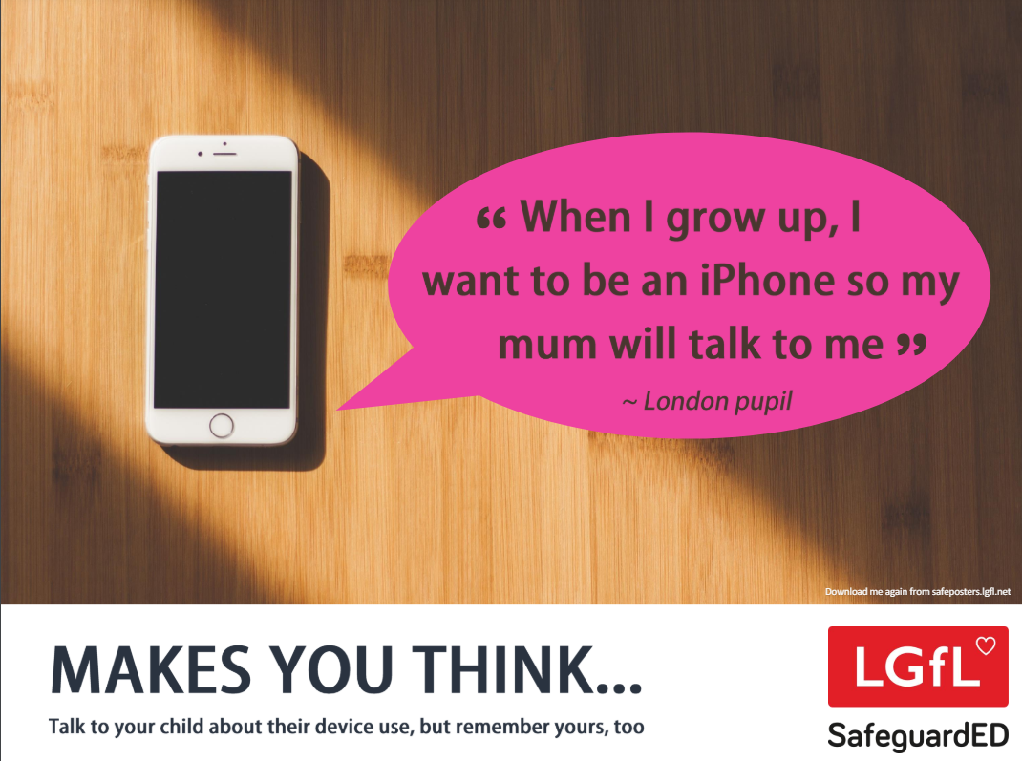
How does your child feel about YOUR SCREENTIME?
52% of 8-11s feel that their parents’ screentime is too high
Source: Children and parents: media use and attitudes report 2025
Notes:
Of the third of online 8-17s who think their screentime is too high, just over half (52%) also think their parents’ screentime is too high, compared with the 15% who do not think their parents screentime is too high, and a quarter (26%) who are not sure.
REMIND – it’s important to model good behaviour when it comes to device use, as children will follow our example. The same goes for ‘sharenting’ (see slide 22)

Slide 34

Notes:
PLAY VIDEO – ‘Life Online - What Grownups Just Don't Get!’
This video is part of our playlist on what children and young people actually think about some of the top topics and hot potatoes of the day in 2024. You can discuss key points from this to facilitate conversations to break down barriers to keeping children safe online.
https://youtu.be/Lde52EtjljQ?si=QZSHL0Gn31LRCO1T

